Slide 1
Prow Under the Hood:
CI/CD for Kubernetes Development
Arka Saha
Software Engineer, VMware by Broadcom
Rayan Das
Senior SRE, OneTrust
Supported By

Slide 2




Who are we?
Arka Saha
Software Engineer, VMware by Broadcom
ArkaSaha30 arkasaha30
Rayan Das
Senior SRE, OneTrust
rayandas raydeeam
Supported By

Slide 3
Agenda
Prow: What and Why?
Types of Prowjobs
Prowjob: How to write yours?
Test your Prowjob
Key Takeaways
Supported By

Slide 4
Prow: What and Why?
Supported By

Slide 5

What is Prow?
Supported By

Slide 6
What is Prow?
Kubernetes based CI/CD System
Supported By

Slide 7
What is Prow?
Kubernetes based CI/CD System
Extensible features
Supported By

Slide 8
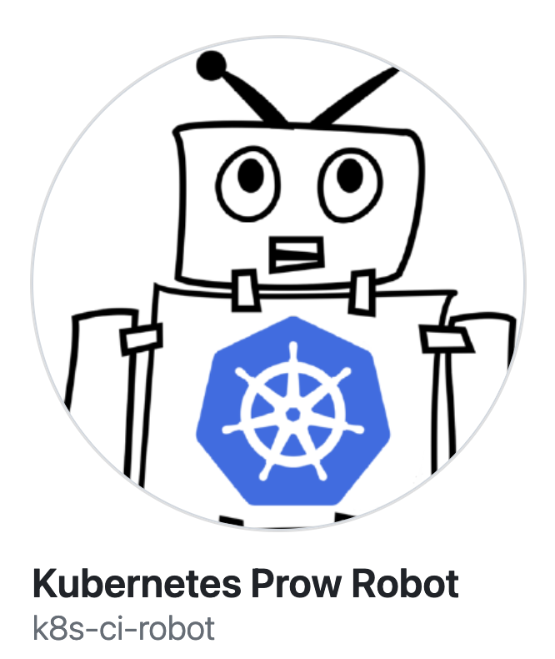
What is Prow?
Kubernetes based CI/CD System
Extensible features
Github Automation
Supported By

Slide 9
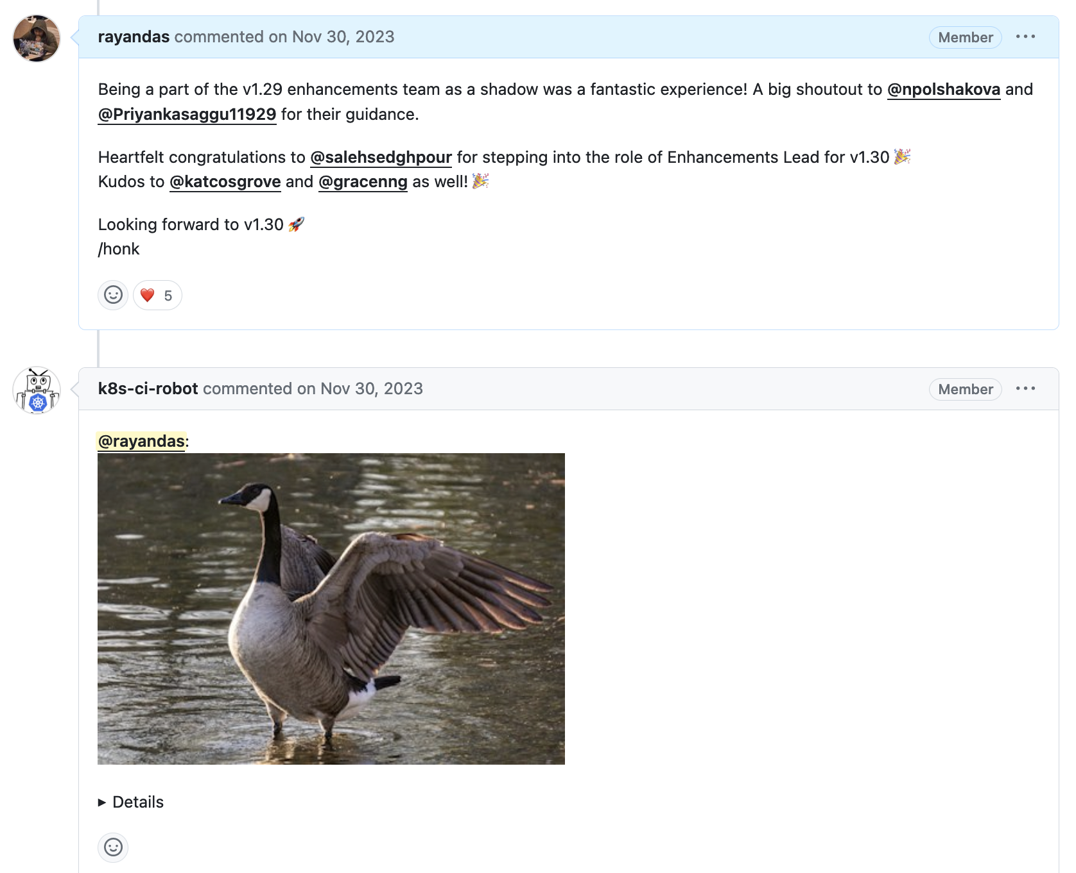
What is Prow?
Kubernetes based CI/CD System
Extensible features
Github Automation
Chatops
Supported By

Slide 10
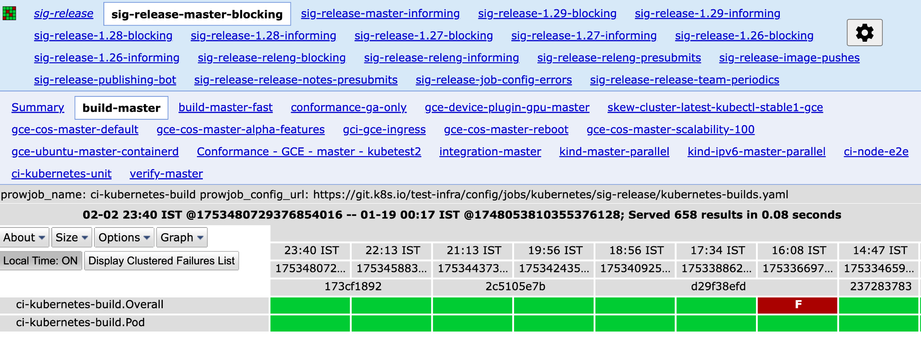
What is Prow?
Kubernetes based CI/CD System
Extensible features
Github Automation
Chatops
Test Grid
Supported By

Slide 11
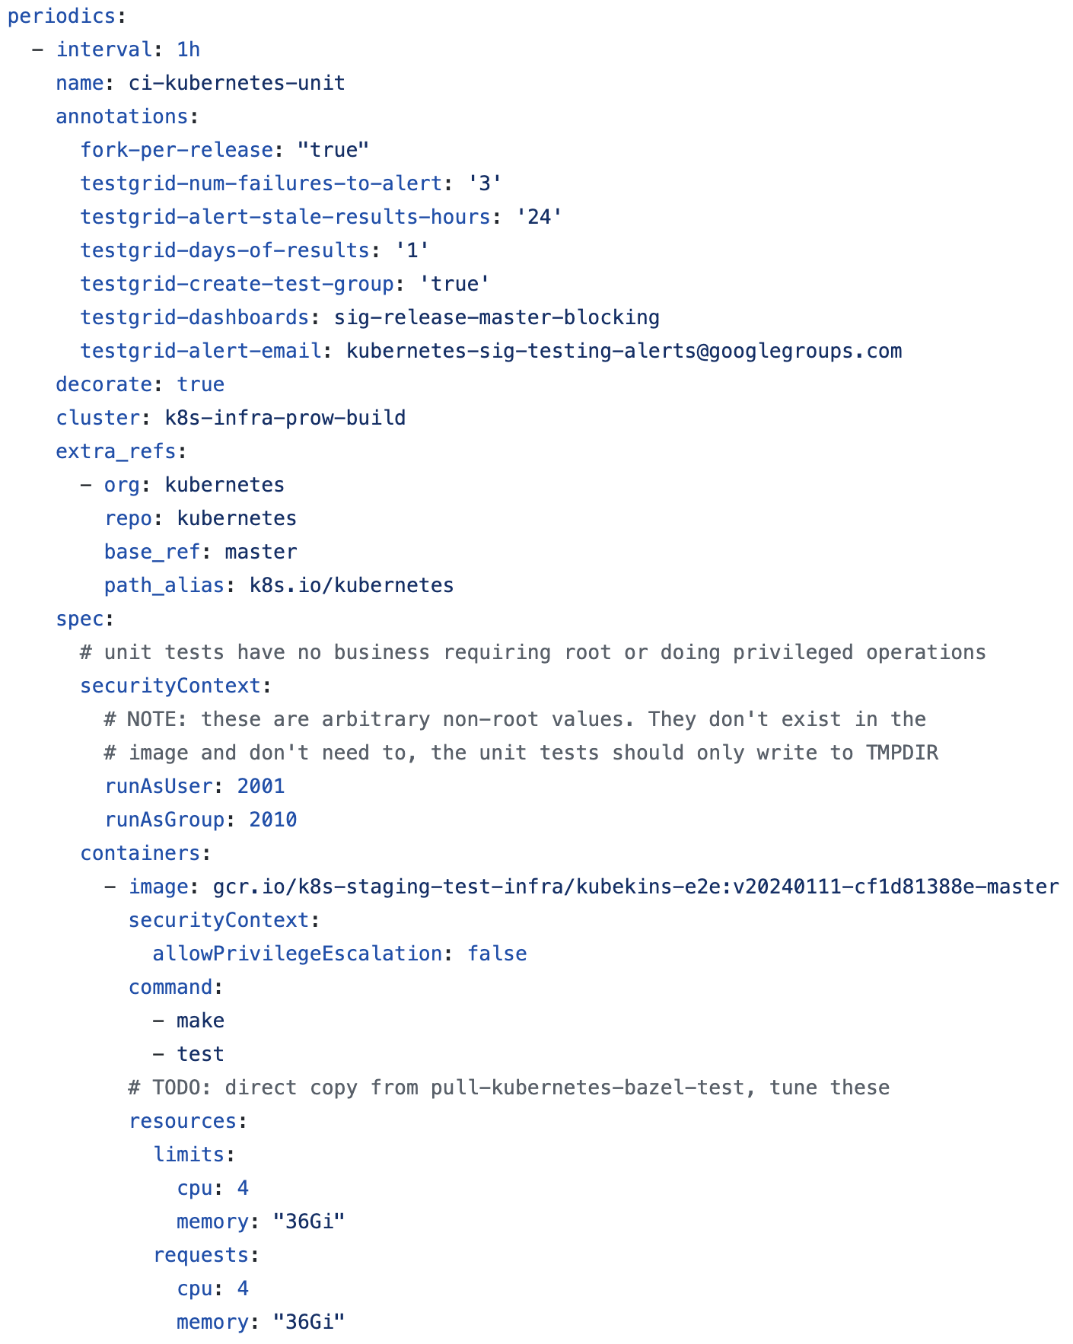
What is Prow?
Kubernetes based CI/CD
Extensible features
Configuration as Code
https://github.com/kubernetes/test-infra/blob/master/config/jobs/kubernetes/sig-testing/make-test.yaml#L149-L188
Supported By

Slide 12


Learn More …
https://www.youtube.com/watch?v=sdU-3cqiJmg
https://www.youtube.com/watch?v=gKKfXTZd7VU
Supported By

Slide 13

Why Prow for CI/CD?
Platform familiarity
Supported By

Slide 14
Why Prow for CI/CD?
Platform familiarity
Reliability
Supported By

Slide 15
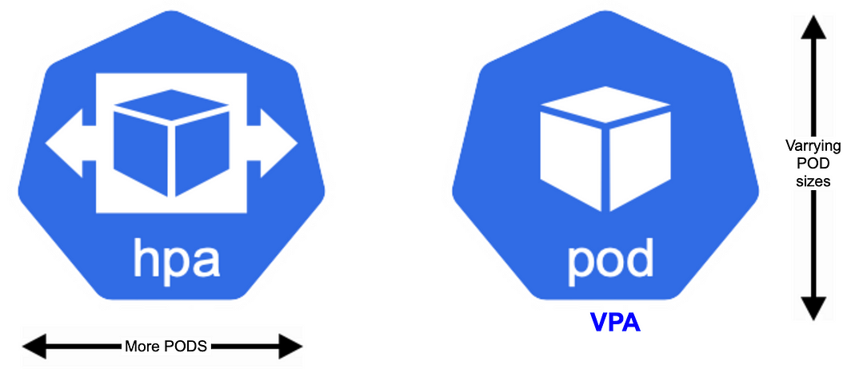
Why Prow for CI/CD?
Platform familiarity
Reliability
Scalability
Supported By

Slide 16
Why Prow for CI/CD?
Platform familiarity
Reliability
Scalability
Monitoring
Supported By

Slide 17
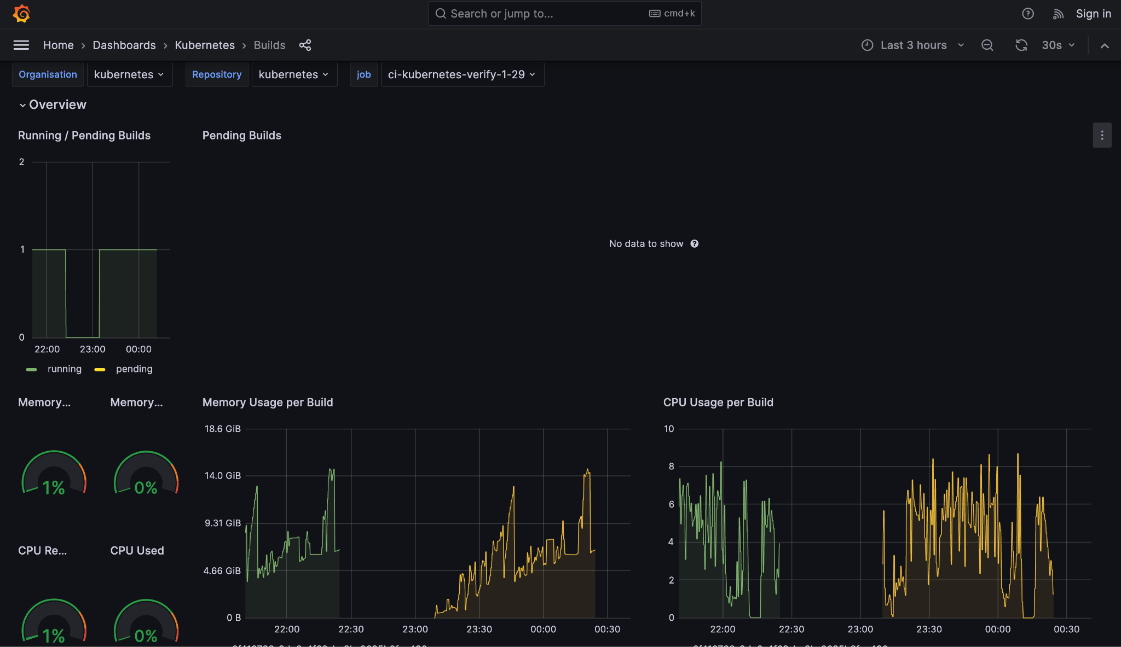
Why Prow for CI/CD?
Platform familiarity
Reliability
Scalability
Monitoring
Infrastructure - Prometheus/Grafana
Supported By

Slide 18
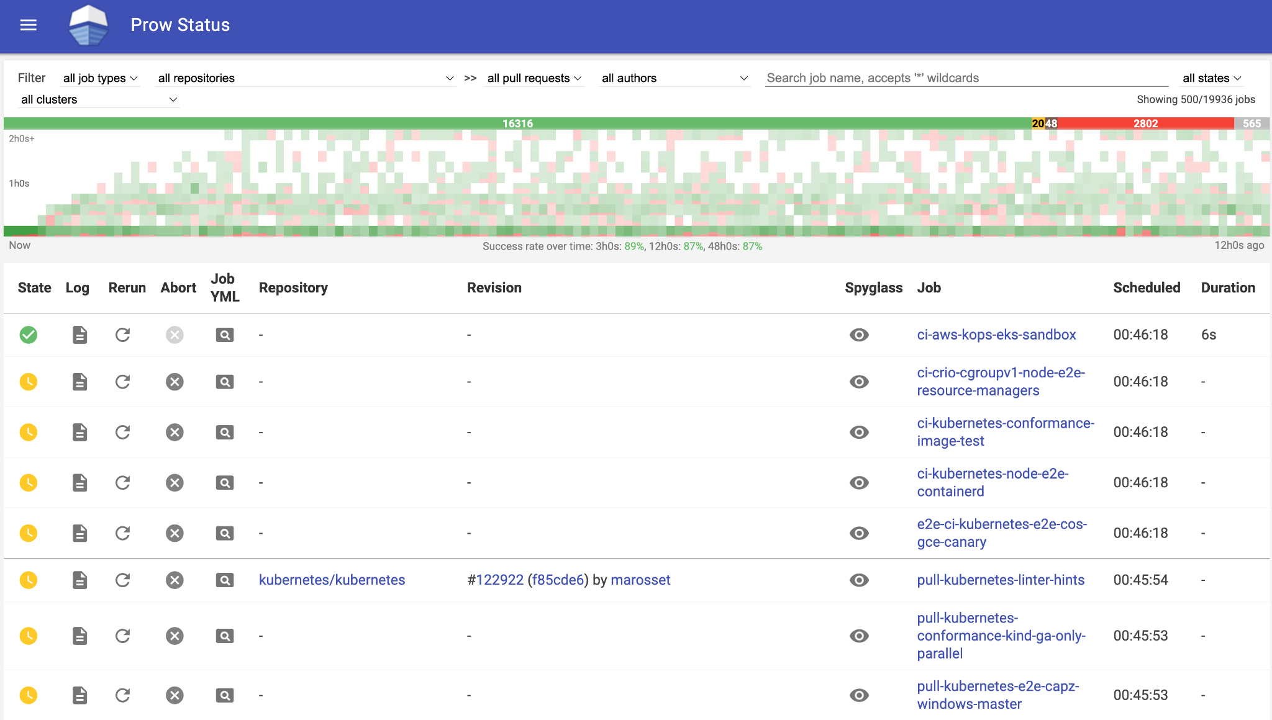
Why Prow for CI/CD?
Platform familiarity
Reliability
Scalability
Monitoring
Infrastructure - Prometheus/Grafana
Workload - Spyglass/Testgrid
Supported By

Slide 19


Why Prow for CI/CD?
Platform familiarity
Reliability
Scalability
Monitoring
Multi-cloud
Supported By

Slide 20
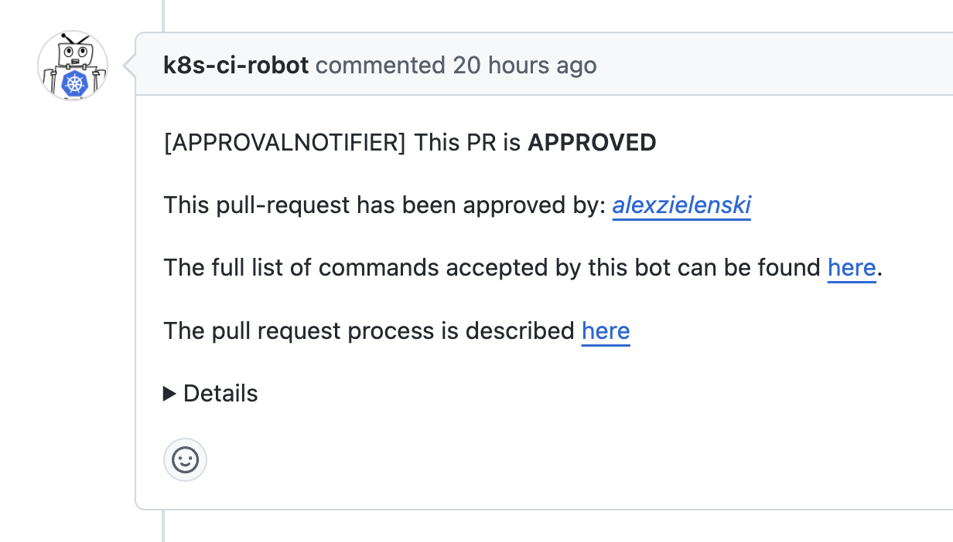
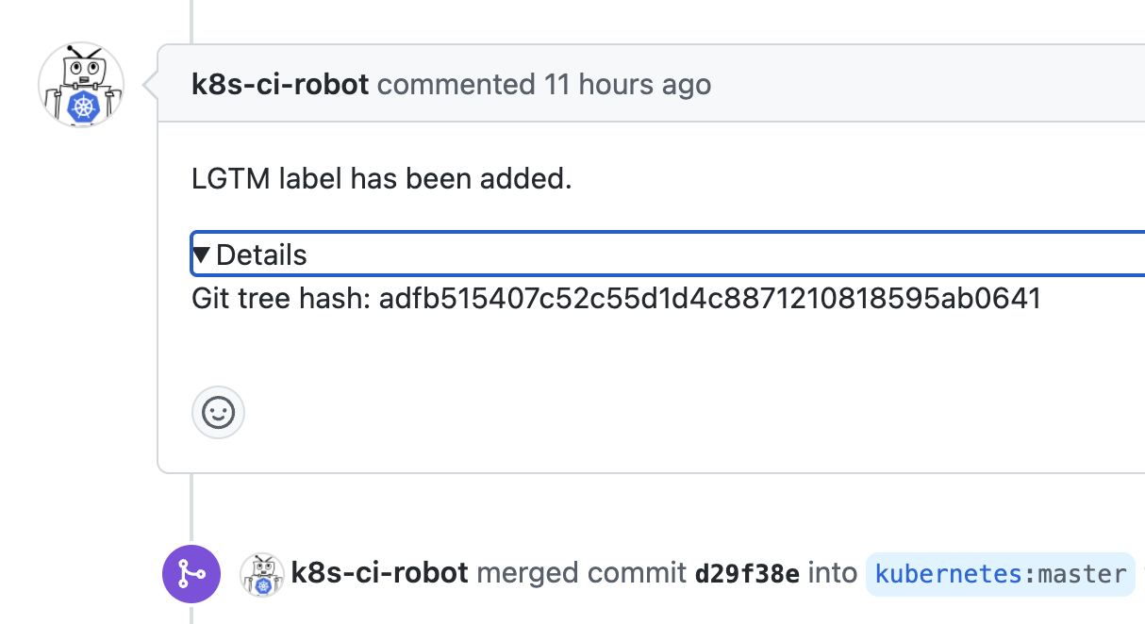
Why Prow for CI/CD?
Platform familiarity
Reliability
Automation
Supported By

Slide 21
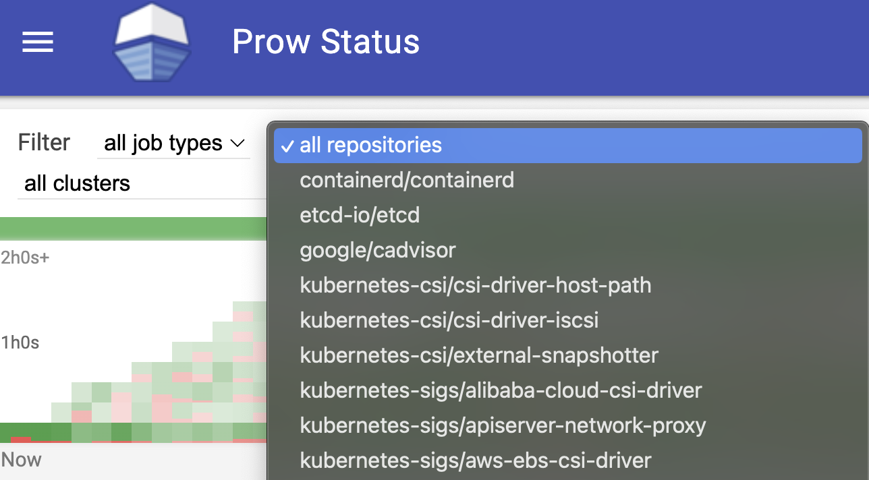
Why Prow for CI/CD?
Platform familiarity
Reliability
Automation
Multi-org/Multi-repo
Supported By

Slide 22
Types of Prowjobs
Supported By

Slide 23
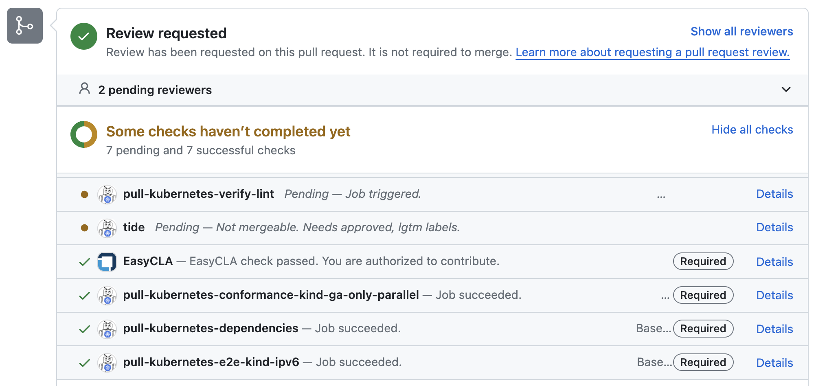
Types of Prowjobs
Presubmits
(triggered against PRs)
Supported By

Slide 24
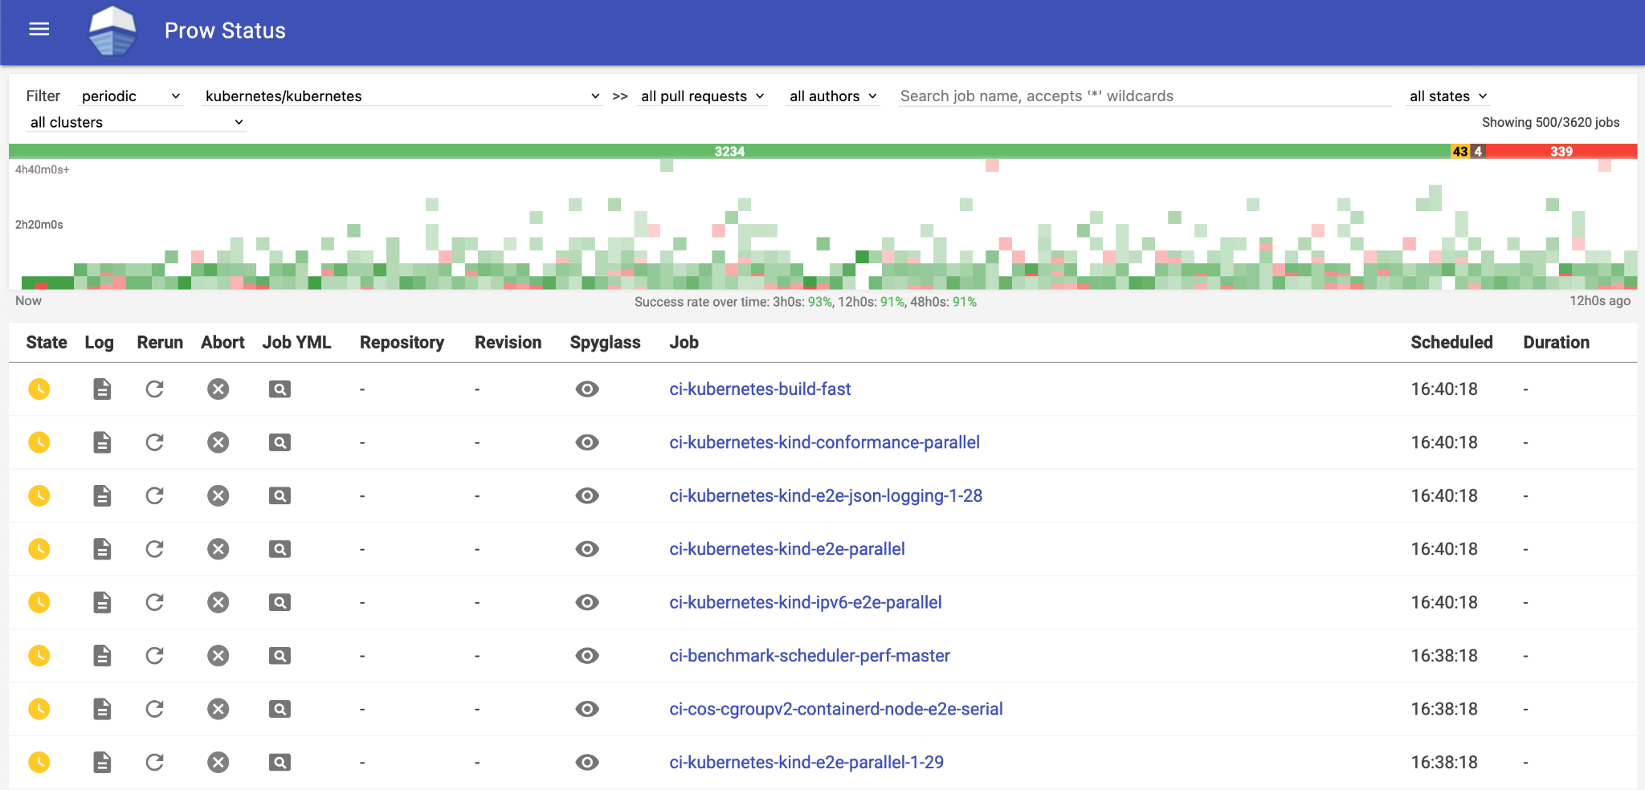
Types of Prowjobs
Presubmits
(triggered against PRs)
Periodics
(triggered recurrently)
Supported By

Slide 25
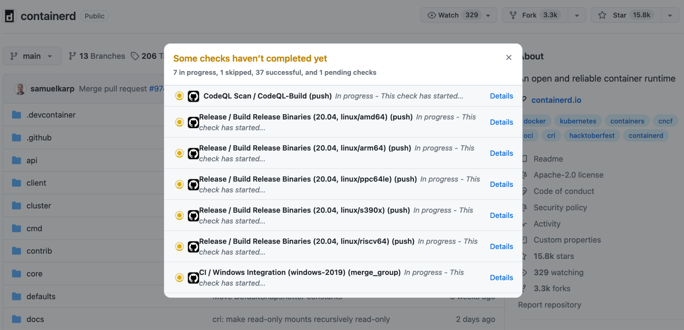
Types of Prowjobs
Presubmits
(triggered against PRs)
Periodics
(triggered recurrently)
Postsubmits
(triggered post-merge of PRs)
Supported By

Slide 26
Prowjob:
How to write yours?
Supported By

Slide 27
Prowjob: How to write yours?
presubmits: postsubmits: periodics:
org/repo: org/repo:
- name: qux-job
labels:
preset-foo-bar: "true"
decorate: true
extra_refs:
- org: org
repo: repo
base_ref: main
always_run: true
max_concurrency: 10
spec: {}
interval: 1h
run_if_changed: "qux/.*"
skip_report: true
context: qux-job
branches: []
skip_branches: []
trigger: "(?m)qux test this( please)?"
rerun_command: "qux test this please"
Common to ALL
Only Presubmits and Postsubmits
Only Periodics
Only Presubmits
Supported By

Slide 28
Prowjob: How to write yours?
presubmits: postsubmits: periodics:
org/repo: org/repo:
- name: qux-job
labels:
preset-foo-bar: "true"
decorate: true
extra_refs:
- org: org
repo: repo
base_ref: main
always_run: true
max_concurrency: 10
spec: {}
interval: 1h
run_if_changed: "qux/.*"
skip_report: true
context: qux-job
branches: []
skip_branches: []
trigger: "(?m)qux test this( please)?"
rerun_command: "qux test this please"
Specifies the type of prowjob
Common to ALL
Only Presubmits and Postsubmits
Only Periodics
Only Presubmits
Supported By

Slide 29
Prowjob: How to write yours?
presubmits: postsubmits: periodics:
org/repo: org/repo:
- name: qux-job
labels:
preset-foo-bar: "true"
decorate: true
extra_refs:
- org: org
repo: repo
base_ref: main
always_run: true
max_concurrency: 10
spec: {}
interval: 1h
run_if_changed: "qux/.*"
skip_report: true
context: qux-job
branches: []
skip_branches: []
trigger: "(?m)qux test this( please)?"
rerun_command: "qux test this please"
Common to ALL
Specifies the repository to clone
Only Presubmits and Postsubmits
Only Periodics
Only Presubmits
Supported By

Slide 30
Prowjob: How to write yours?
presubmits: postsubmits: periodics:
org/repo: org/repo:
- name: qux-job
labels:
preset-foo-bar: "true"
decorate: true
extra_refs:
- org: org
repo: repo
base_ref: main
always_run: true
max_concurrency: 10
spec: {}
interval: 1h
run_if_changed: "qux/.*"
skip_report: true
context: qux-job
branches: []
skip_branches: []
trigger: "(?m)qux test this( please)?"
rerun_command: "qux test this please"
Common to ALL
Only Presubmits and Postsubmits
Specifies the name of prowjob
matching regex: ^[A-Za-z0-9-._]+$
Only Periodics
Only Presubmits
Supported By

Slide 31
Prowjob: How to write yours?
presubmits: postsubmits: periodics:
org/repo: org/repo:
- name: qux-job
labels:
preset-foo-bar: "true"
decorate: true
extra_refs:
- org: org
repo: repo
base_ref: main
always_run: true
max_concurrency: 10
spec: {}
interval: 1h
run_if_changed: "qux/.*"
skip_report: true
context: qux-job
branches: []
skip_branches: []
trigger: "(?m)qux test this( please)?"
rerun_command: "qux test this please"
Common to ALL
Only Presubmits and Postsubmits
Enables addition of this preset to the job container
Only Periodics
Only Presubmits
Supported By

Slide 32
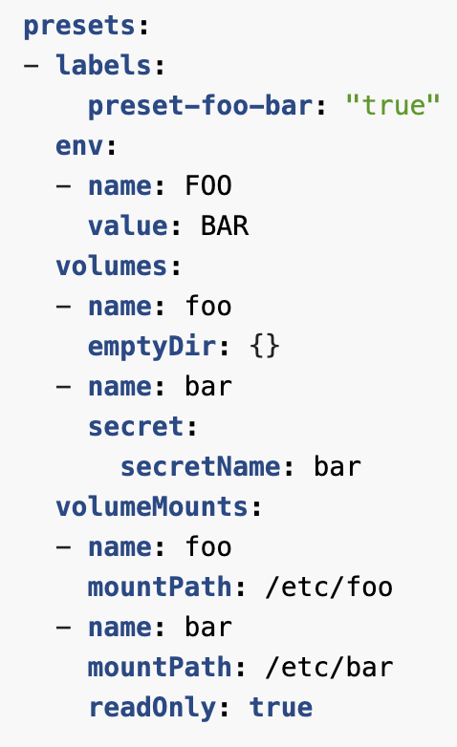
Prowjob: How to write yours?
presubmits: postsubmits: periodics:
org/repo: org/repo:
- name: qux-job
labels:
preset-foo-bar: "true"
decorate: true
extra_refs:
- org: org
repo: repo
base_ref: main
always_run: true
max_concurrency: 10
spec: {}
interval: 1h
run_if_changed: "qux/.*"
skip_report: true
context: qux-job
branches: []
skip_branches: []
trigger: "(?m)qux test this( please)?"
rerun_command: "qux test this please"
Common to ALL
Only Presubmits and Postsubmits
Enables addition of this preset to the job container
Only Periodics
Only Presubmits
Supported By

Slide 33
Prowjob: How to write yours?
presubmits: postsubmits: periodics:
org/repo: org/repo:
- name: qux-job
labels:
preset-foo-bar: "true"
decorate: true
extra_refs:
- org: org
repo: repo
base_ref: main
always_run: true
max_concurrency: 10
spec: {}
interval: 1h
run_if_changed: "qux/.*"
skip_report: true
context: qux-job
branches: []
skip_branches: []
trigger: "(?m)qux test this( please)?"
rerun_command: "qux test this please"
Common to ALL
Only Presubmits and Postsubmits
Only Periodics
Only Presubmits
Enables podutils
https://docs.prow.k8s.io/docs/components/pod-utilities/
Supported By

Slide 34
Prowjob: How to write yours?
presubmits: postsubmits: periodics:
org/repo: org/repo:
- name: qux-job
labels:
preset-foo-bar: "true"
decorate: true
extra_refs:
- org: org
repo: repo
base_ref: main
always_run: true
max_concurrency: 10
spec: {}
interval: 1h
run_if_changed: "qux/.*"
skip_report: true
context: qux-job
branches: []
skip_branches: []
trigger: "(?m)qux test this( please)?"
rerun_command: "qux test this please"
Common to ALL
Only Presubmits and Postsubmits
Only Periodics
Only Presubmits
Org, repo, branch to clone
Supported By

Slide 35
Prowjob: How to write yours?
presubmits: postsubmits: periodics:
org/repo: org/repo:
- name: qux-job
labels:
preset-foo-bar: "true"
decorate: true
extra_refs:
- org: org
repo: repo
base_ref: main
always_run: true
max_concurrency: 10
spec: {}
interval: 1h
run_if_changed: "qux/.*"
skip_report: true
context: qux-job
branches: []
skip_branches: []
trigger: "(?m)qux test this( please)?"
rerun_command: "qux test this please"
Common to ALL
Only Presubmits and Postsubmits
Only Periodics
Only Presubmits
Specifies to run on every PR/run request
Supported By

Slide 36
Prowjob: How to write yours?
presubmits: postsubmits: periodics:
org/repo: org/repo:
- name: qux-job
labels:
preset-foo-bar: "true"
decorate: true
extra_refs:
- org: org
repo: repo
base_ref: main
always_run: true
max_concurrency: 10
spec: {}
interval: 1h
run_if_changed: "qux/.*"
skip_report: true
context: qux-job
branches: []
skip_branches: []
trigger: "(?m)qux test this( please)?"
rerun_command: "qux test this please"
Common to ALL
Only Presubmits and Postsubmits
Only Periodics
Only Presubmits
Run max this many job instances concurrently
Supported By

Slide 37
Prowjob: How to write yours?
presubmits: postsubmits: periodics:
org/repo: org/repo:
- name: qux-job
labels:
preset-foo-bar: "true"
decorate: true
extra_refs:
- org: org
repo: repo
base_ref: main
always_run: true
max_concurrency: 10
spec: {}
interval: 1h
run_if_changed: "qux/.*"
skip_report: true
context: qux-job
branches: []
skip_branches: []
trigger: "(?m)qux test this( please)?"
rerun_command: "qux test this please"
Common to ALL
Only Presubmits and Postsubmits
Only Periodics
Only Presubmits
Valid Kubernetes pod spec
Supported By

Slide 38
Prowjob: How to write yours?
presubmits: postsubmits: periodics:
org/repo: org/repo:
- name: qux-job
labels:
preset-foo-bar: "true"
decorate: true
extra_refs:
- org: org
repo: repo
base_ref: main
always_run: true
max_concurrency: 10
spec: {}
interval: 1h
run_if_changed: "qux/.*"
skip_report: true
context: qux-job
branches: []
skip_branches: []
trigger: "(?m)qux test this( please)?"
rerun_command: "qux test this please"
Common to ALL
Only Presubmits and Postsubmits
Only Periodics
Only Presubmits
Frequency of the periodic job to run
Supported By

Slide 39
Prowjob: How to write yours?
presubmits: postsubmits: periodics:
org/repo: org/repo:
- name: qux-job
labels:
preset-foo-bar: "true"
decorate: true
extra_refs:
- org: org
repo: repo
base_ref: main
always_run: true
max_concurrency: 10
spec: {}
interval: 1h
run_if_changed: "qux/.*"
skip_report: true
context: qux-job
branches: []
skip_branches: []
trigger: "(?m)qux test this( please)?"
rerun_command: "qux test this please"
Common to ALL
Only Presubmits and Postsubmits
Only Periodics
Only Presubmits
Run if regex condition is met
Supported By

Slide 40
Prowjob: How to write yours?
presubmits: postsubmits: periodics:
org/repo: org/repo:
- name: qux-job
labels:
preset-foo-bar: "true"
decorate: true
extra_refs:
- org: org
repo: repo
base_ref: main
always_run: true
max_concurrency: 10
spec: {}
interval: 1h
run_if_changed: "qux/.*"
skip_report: true
context: qux-job
branches: []
skip_branches: []
trigger: "(?m)qux test this( please)?"
rerun_command: "qux test this please"
Common to ALL
Only Presubmits and Postsubmits
Only Periodics
Only Presubmits
Skip(or not) setting a Github status
Supported By

Slide 41
Prowjob: How to write yours?
presubmits: postsubmits: periodics:
org/repo: org/repo:
- name: qux-job
labels:
preset-foo-bar: "true"
decorate: true
extra_refs:
- org: org
repo: repo
base_ref: main
always_run: true
max_concurrency: 10
spec: {}
interval: 1h
run_if_changed: "qux/.*"
skip_report: true
context: qux-job
branches: []
skip_branches: []
trigger: "(?m)qux test this( please)?"
rerun_command: "qux test this please"
Common to ALL
Only Presubmits and Postsubmits
Only Periodics
Only Presubmits
Status context, same as job name.
Supported By

Slide 42
Prowjob: How to write yours?
presubmits: postsubmits: periodics:
org/repo: org/repo:
- name: qux-job
labels:
preset-foo-bar: "true"
decorate: true
extra_refs:
- org: org
repo: repo
base_ref: main
always_run: true
max_concurrency: 10
spec: {}
interval: 1h
run_if_changed: "qux/.*"
skip_report: true
context: qux-job
branches: []
skip_branches: []
trigger: "(?m)qux test this( please)?"
rerun_command: "qux test this please"
Common to ALL
Only Presubmits and Postsubmits
Only Periodics
Only Presubmits
List branches to run/skip, not used together
Supported By

Slide 43
Prowjob: How to write yours?
presubmits: postsubmits: periodics:
org/repo: org/repo:
- name: qux-job
labels:
preset-foo-bar: "true"
decorate: true
extra_refs:
- org: org
repo: repo
base_ref: main
always_run: true
max_concurrency: 10
spec: {}
interval: 1h
run_if_changed: "qux/.*"
skip_report: true
context: qux-job
branches: []
skip_branches: []
trigger: "(?m)qux test this( please)?"
rerun_command: "qux test this please"
Common to ALL
Only Presubmits and Postsubmits
Only Periodics
Only Presubmits
The trigger regex should match the rerun_command for use to trigger via chatops
Supported By

Slide 44
Test your Prowjob
Supported By

Slide 45
Local Test: pj-on-kind
Runs prowjobs as pods in a kind cluster
Supported By

Slide 46
Local Test: pj-on-kind
Runs prowjobs as pods in a kind cluster
Prerequisites/configuration: https://docs.prow.k8s.io/docs/build-test-update/#running-a-prowjob-locally
Supported By

Slide 47
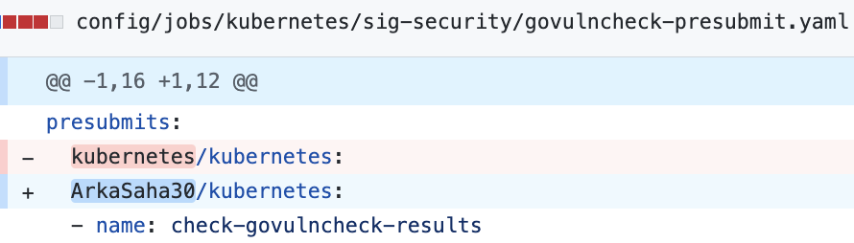
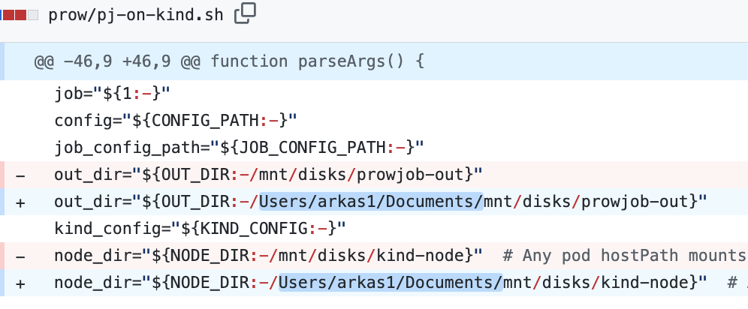
Local Test: pj-on-kind
Runs prowjobs as pods in a kind cluster
Prerequisites/configuration:
https://docs.prow.k8s.io/docs/build-test-update/#running-a-prowjob-locally
Minimal configuration:
Supported By

Slide 48

Local Test: pj-on-kind
Supported By

Slide 49
Key Takeaways
Supported By

Slide 50
Key Takeaways
Getting familiar with test-infra
Automation scopes
Writing and testing prowjobs
Reliable and quality code via Prow
Supported By

Slide 51

Questions?
Supported By

Slide 52
Thank You
Supported By

